Slide 1
ODPi: Unifying Metadata for Management and Governance
Ferd Scheepers, ING,
John Mertic, Linux Foundation and
Mandy Chessell, IBM

Slide 2
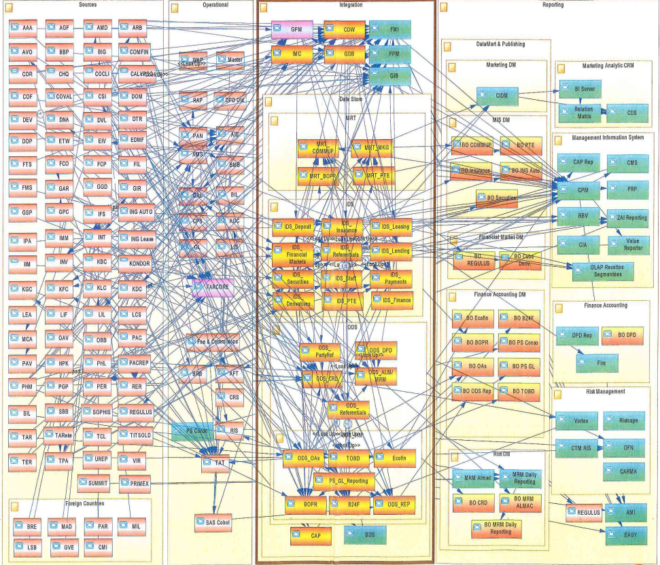
Real Data Landscapes
Many enterprises have had 40 years of innovation embedded into their IT Systems.
Data Science projects spend a lot of time finding and validating data.
There is often a delay moving real-time analytics from POC into production.

Slide 3
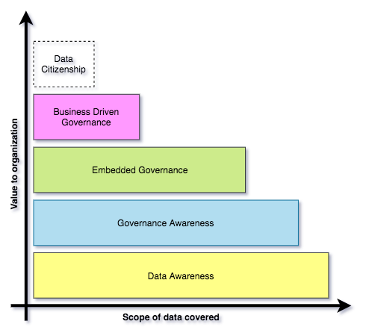
Building governance maturity is a gradual process
Organizations may operate different levels of maturity in different parts of their business.
Choices determined by where the most value lies.
Many organizations aspire to provide all employees with the data they need (data citizenship*)

Slide 4
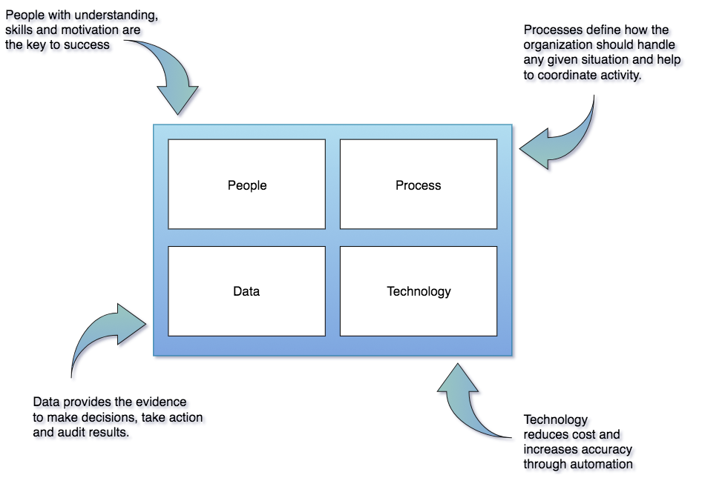
Governance program components

Slide 5
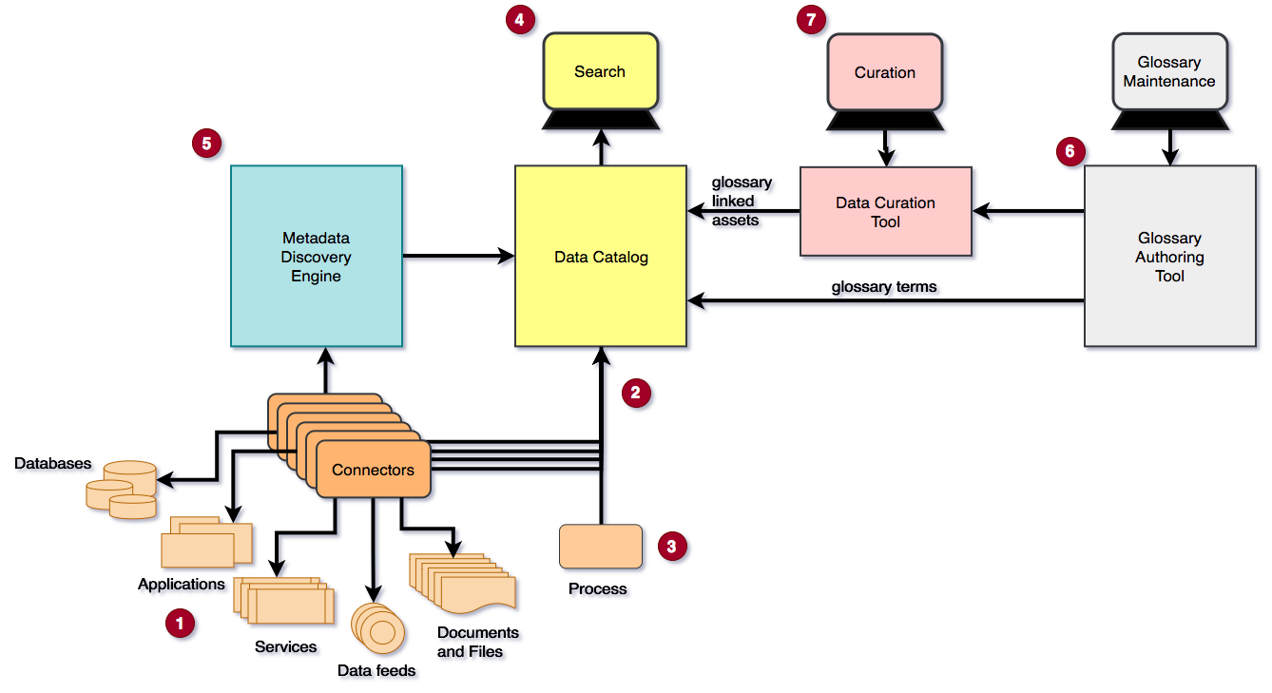
Implementing Data Awareness

Slide 6
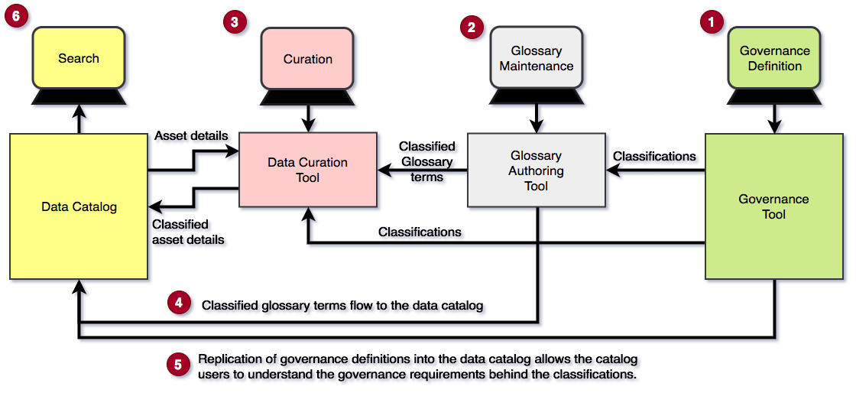
Implementing Governance Awareness

Slide 7
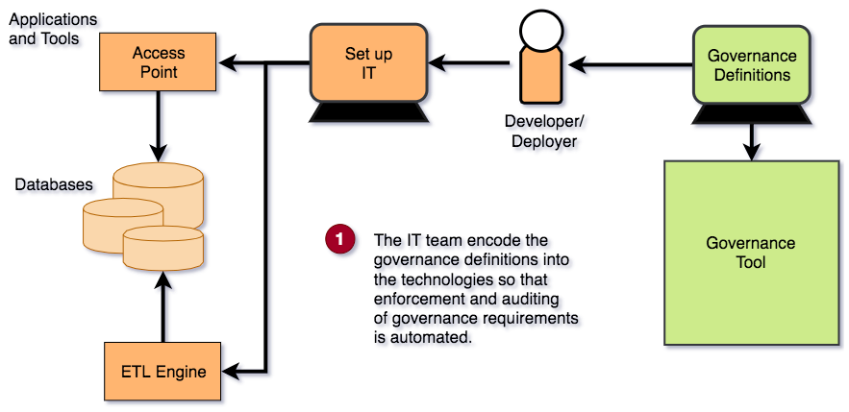
Implementing Embedded Governance

Slide 8
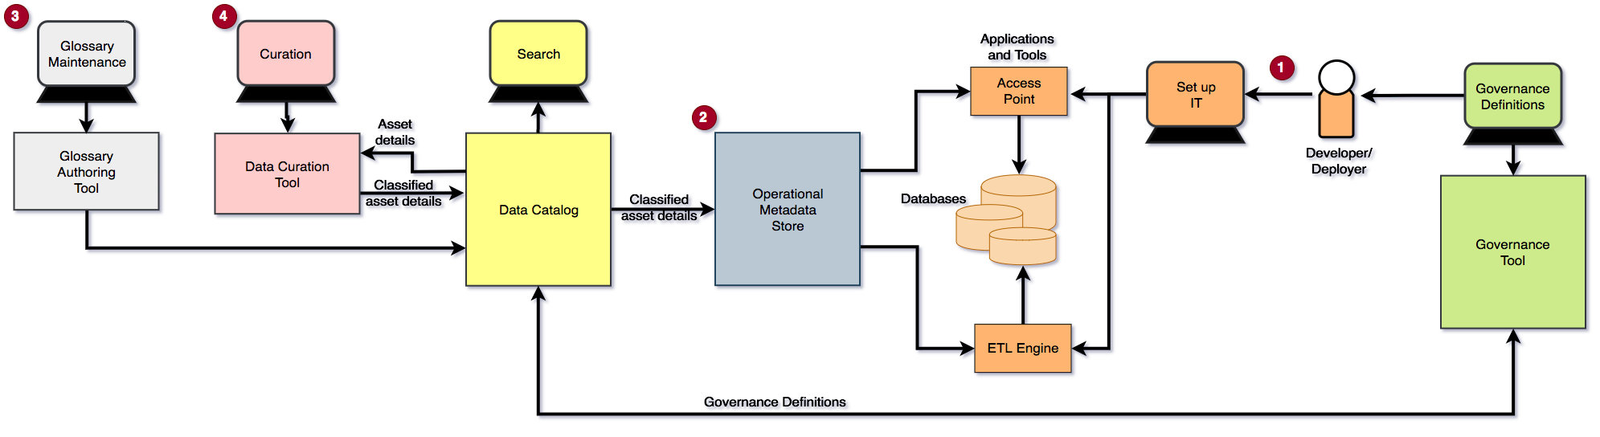
Implementing Business Driven Governance

Slide 9
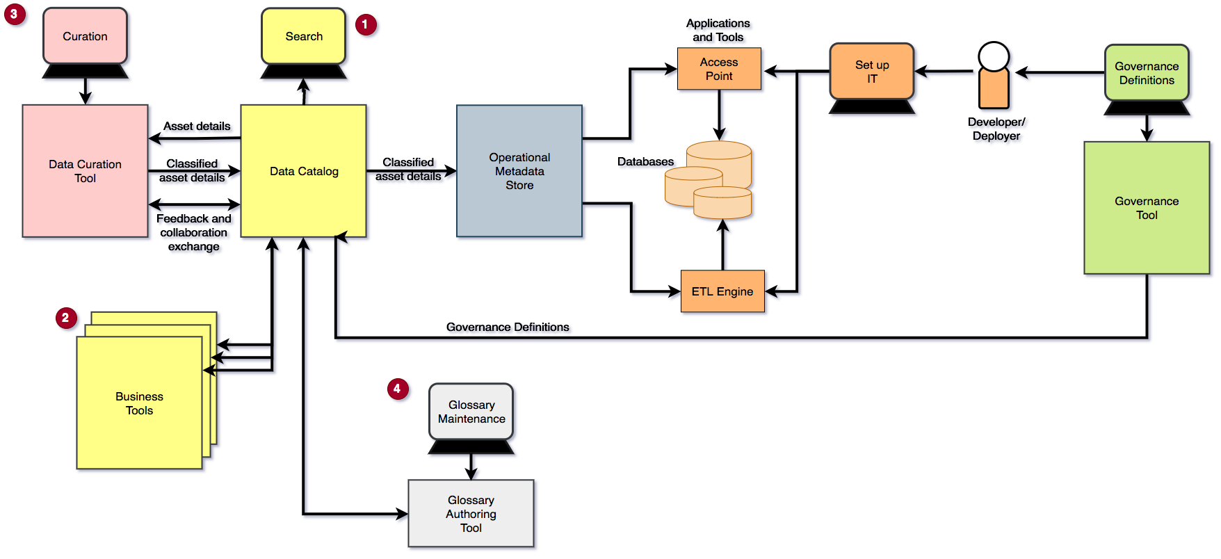
Implementing Data Citizenship

Slide 10
Observations from the maturity model
The number of bespoke integrations between tools to exchange metadata so it is consistently available to everyone who needs it grows steadily with each step up in maturity.
With little to no standardization between vendors, the cost and time delay is born by the organization.

Slide 11
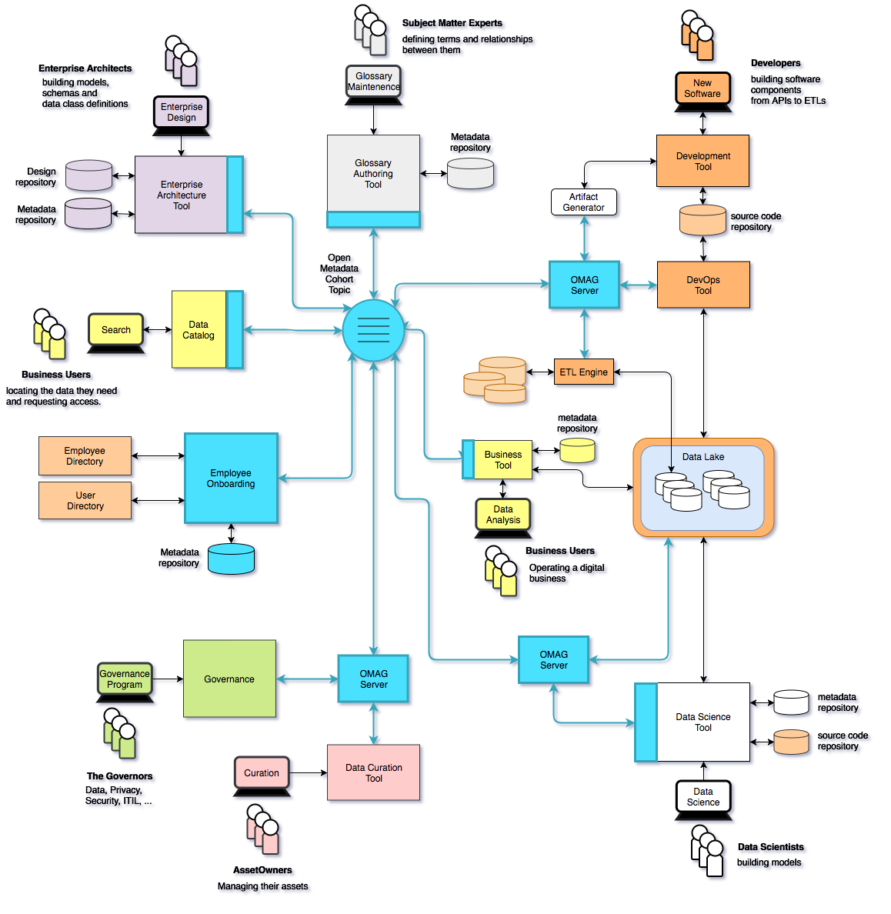
Using Egeria …
Eases the cost of metadata integration through
Comprehensive standards and libraries.
Active vendor recruitment program.
Provides direct support to many governance roles, filling the gaps between function offered through commercial tools.

Slide 12
Example of a simple cohort
Data Lake
Cohort A
Chief Data Office
Systems of Record

Slide 13
Connecting to multiple cohorts
Data Lake
Marketing
Data Lake
Cohort A
Cohort B
Chief Data Office
Systems of Record
Systems of Record
Mobile
Apps

Slide 14
Importance of the Graph Model
Database
Column
Glossary Term
Server 1
Server 2
Entity
Entity

Slide 15
Importance of the Graph Model
Database
Column
Glossary Term
Glossary
Term
Meaning
Server 1
Server 2
Reference
Copy
Relationship

Slide 16
Importance of the Graph Model
Database
Column
Glossary
Term
Server 1
Server 2
Database Column
Glossary
Term
Meaning
Server 3

Slide 17
Importance of the Graph Model – Using Entity Proxies
Database
Column
Glossary
Term
Server 1
Server 2
Entity
Proxy
Database
Column
Glossary
Term
Meaning
Server 3

Slide 18
Metadata and governance digital platform
Governance Platform
Reporting Platform
Analytics Platform
Open Metadata and Governance
Data Platform
ETL Platform
Virtualization Platform

Slide 19
Design philosophy
Use cases,
Personas,
Practitioners
input
Search
Open Metadata Access Services
Open Metadata Repository Services
Data integration, availability and integrity best practices

Slide 20
Coco Pharmaceuticals persona
https://odpi.github.io/data-governance/coco-pharmaceuticals/personas/

Slide 21
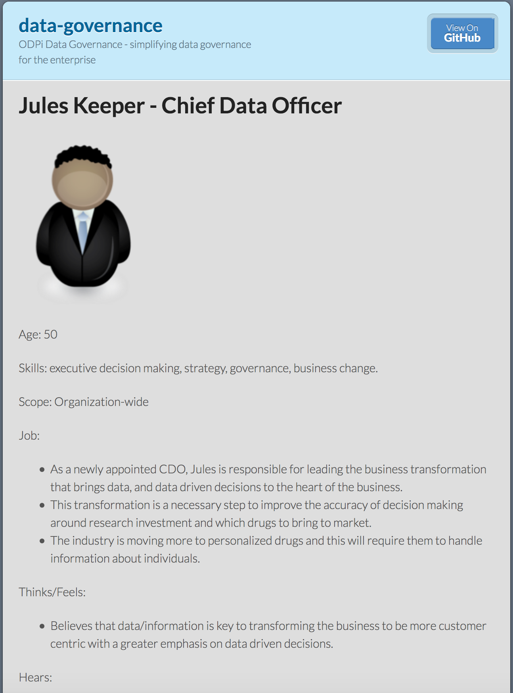
Using design thinking
Open Metadata Types
Access Service Identification
Samples and API design
Best Practices

Slide 22


Different personas need different services
Callie Quartile
Data Scientist
Find data
Understand data
Manage analytics models
Build data strategy
Define governance program
Monitor progress
Jules Keeper
Chief Data Officer

Slide 23


Different personas need different services
Tanya Tidie
Clinical Trials Administrator
Maintain accurate patient records
Catalog clinical trials data
Demonstrate good data management practices
Understand risks to organization
Set up protection
Monitor for suspicious activity
Ivor Padlock
Chief Security Officer

Slide 24


Event-driven governance
Assign
Owner
New
Database
Open
Metadata
Classify
Data
Use
Data

Slide 25
Open metadata type model summary
Governance
Glossary
Collaboration
Models and
Reference Data
Lineage
Metadata
Discovery
Data Assets
Base Types, Systems
and Infrastructure

Slide 26
Each area caters for appropriate metadata structures
Strategy
4
Subject Area Definition
1
Teaming Metadata
(people profiles, communities, projects,
notebooks, …)
Policy Metadata (Principles, Regulations, Standards, Approaches, Rule Specifications, Roles and Metrics)
Business Objects and Relationships, Taxonomies and Ontologies
Augmentation
3
Organization
Feedback Metadata
(tags, comments, ratings, …)
Rollout
Classification
Business Attributes
Campaigns and Projects
Classification Schemes
Implementation
Mapping
Governance Actions and Processes
Rights
Management
Models and Schemas
2
Asset Collections
(Sets, Typed Sets, Type Organized Sets)
Reference Data
5
Instrument
7
Information Process
Instrumentation (design lineage)
Association
Information Views
Augmentation
Discovery
Metadata (profile data, technical classification, data classification,
data quality assessment, …)
Physical Asset Descriptions
(Data stores, APIs,
models and components)
0
Basic Types, Infrastructure and Systems
Access
6
Connectors

Slide 27
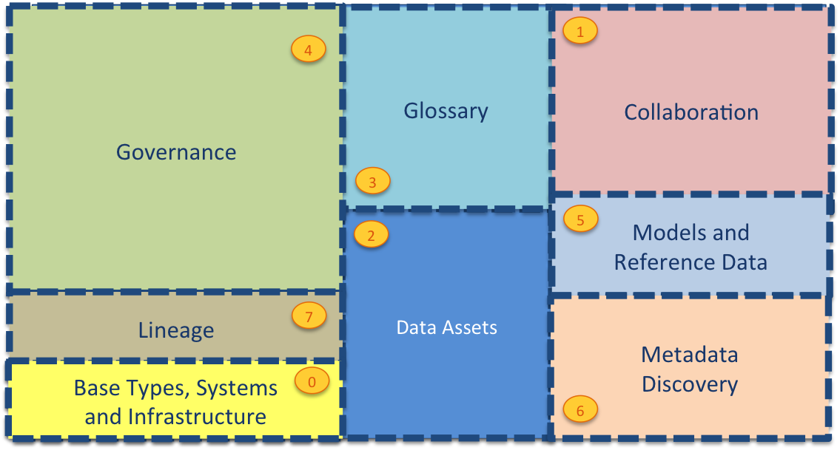
Current Open Metadata Access Services (OMASs)
Asset Consumer
Asset Owner
Asset Lineage
Subject Area
Asset Catalog
Community Profile
Stewardship Action
Project Management
Information View
Data Science
Governance Program
Software Developer
Data Privacy
Digital Architecture
Data Process
Data Protection
DevOps
Governance Engine
Data Infrastructure
Data Platform
Connected Asset
Discovery Engine

Slide 28

Automating governance example
Define Policies
Hadoop Metadata
Open
Governance APIs
Access
Data
IBM
Information
Governance
Catalog
Apache Atlas
Egeria
configure
Gaian
configure
Apache Ranger
Manage Data Access
Egeria
(Open metadata exchange and federated queries)

Slide 29
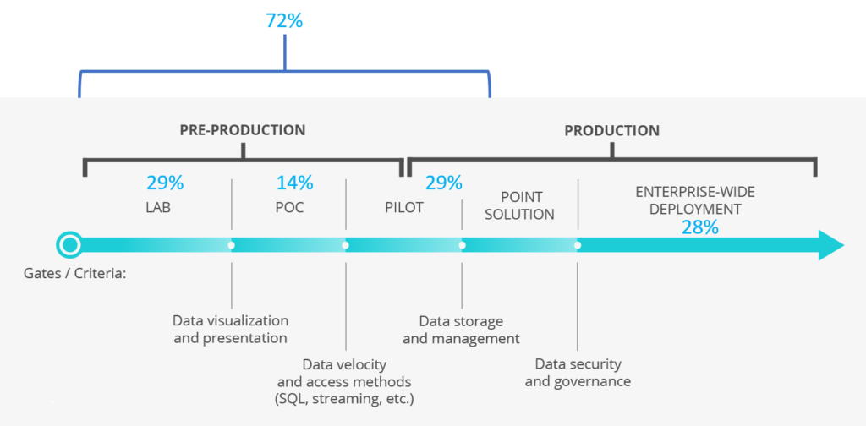
ODPi – A neutral home for collaboration
Notes:
ODPi, a Linux Foundation Project, can provide the platform for industry collaboration on shared technology
In pursuit of its mission to make Apache Hadoop and associated Big Data solutions ready for enterprise-wide deployment, ODPi is focused on the biggest hurdles
In 2016, the largest hurdles were cross-distro harmonization
Today, a key blocker to broad-based production use of Big Data is Governance

Slide 30
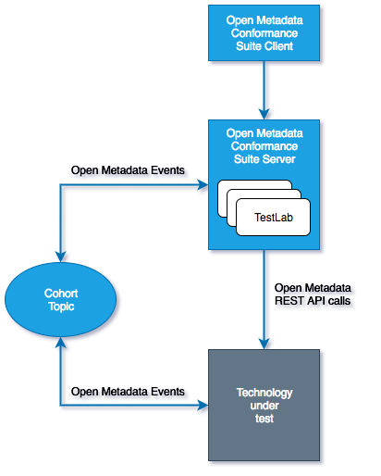
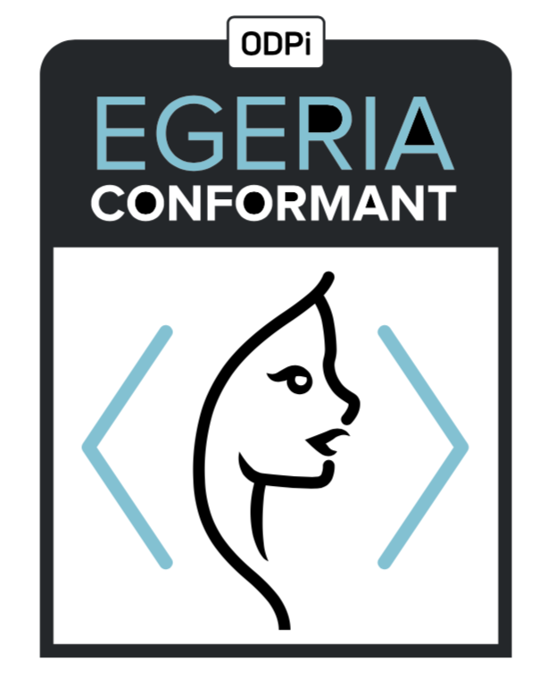
Egeria Conformance Program - its an “imitation game”

Slide 31
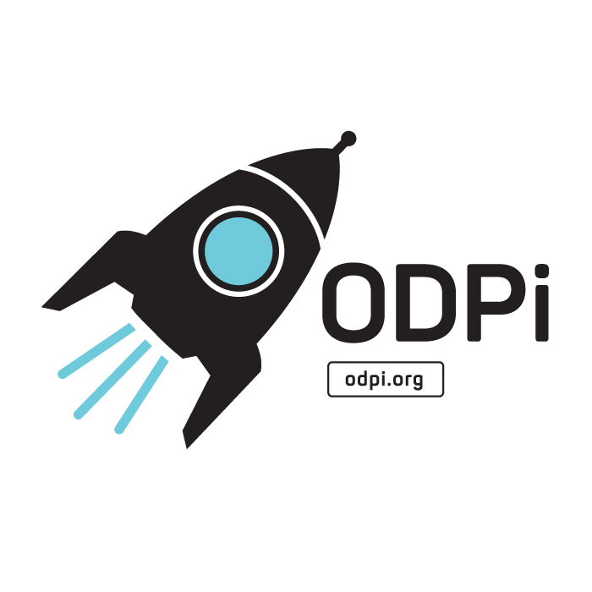



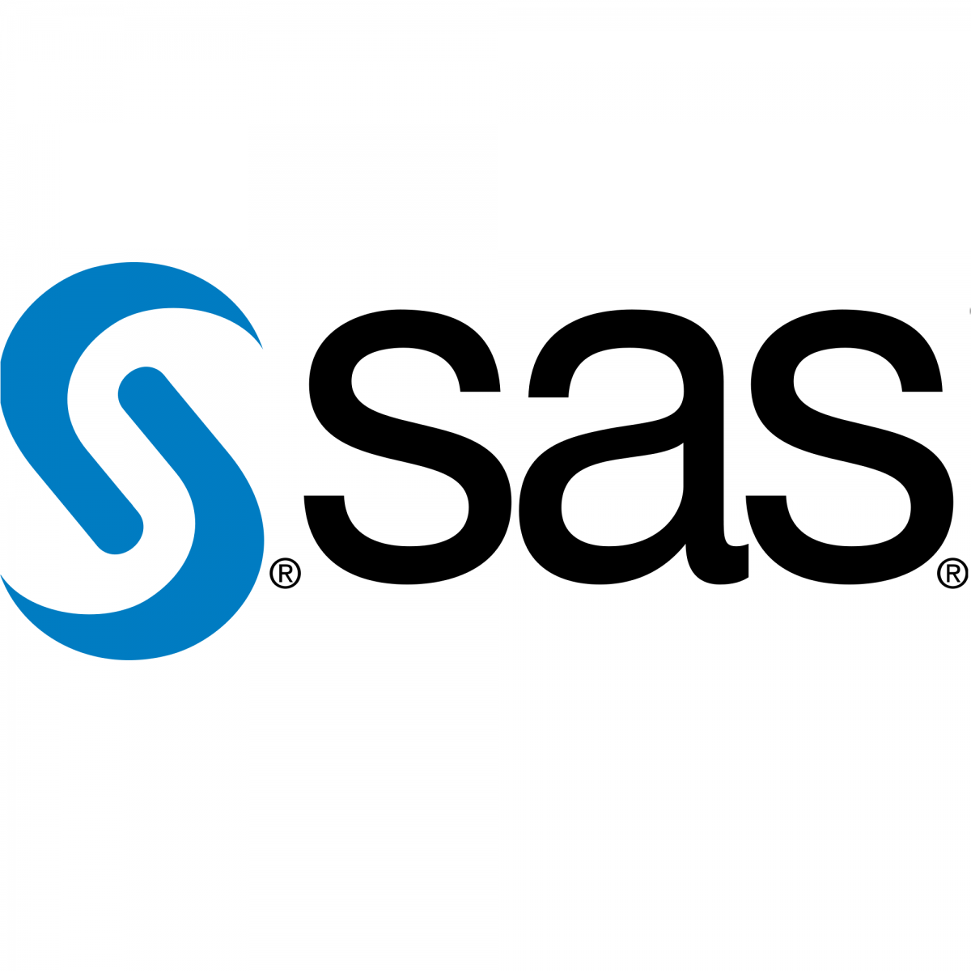
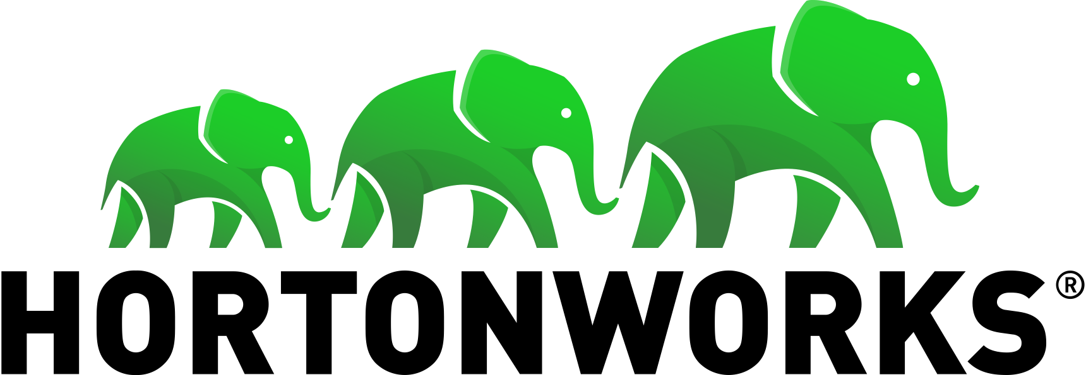
Realizing open metadata and governance
Delivering core technology
Recruiting vendors
Assisting practitioners
Core Technology
Vendors
Project
Egeria
Compliance Suite
Practitioners
Best Practices
Project
Data
Governance

Slide 32
Help wanted
Governance practice leaders needed to build out best practices
If you buy data technology please encourage your vendors to consume the Egeria technology.
Looking for developers:
UI development
Graph repository (eg JanusGraph/TinkerPop)
Python clients
Join the ODPi to help fund our work
Tell everyone about want we do

Slide 33
Open forum
z
z
z
z
z
z
z
Questions?

Slide 34
Links
Press Release and Podcast
Open source repositories
https://www.linuxfoundation.org/press-release/2018/08/odpi-announces-egeria-for-open-sharing-exchange-and-governance-of-metadata/
https://roaringelephant.org/2018/09/25/episode-107-open-metadata-and-governance-masterclass-with-mandy-chessell-part-1/
https://roaringelephant.org/2018/10/09/episode-109-open-metadata-and-governance-
masterclass-with-mandy-chessell-part-2/
https://github.com/odpi/data-governance
https://github.com/odpi/egeria

Slide 35
